Slide 1
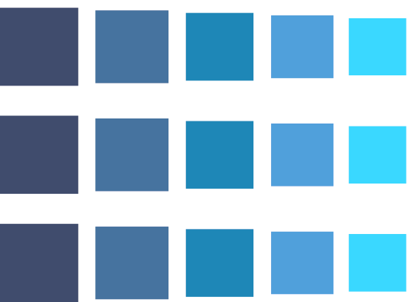



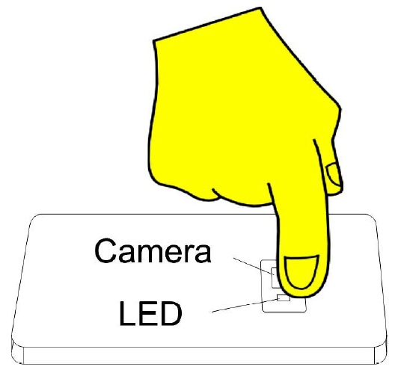

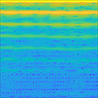
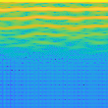
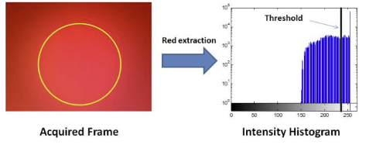
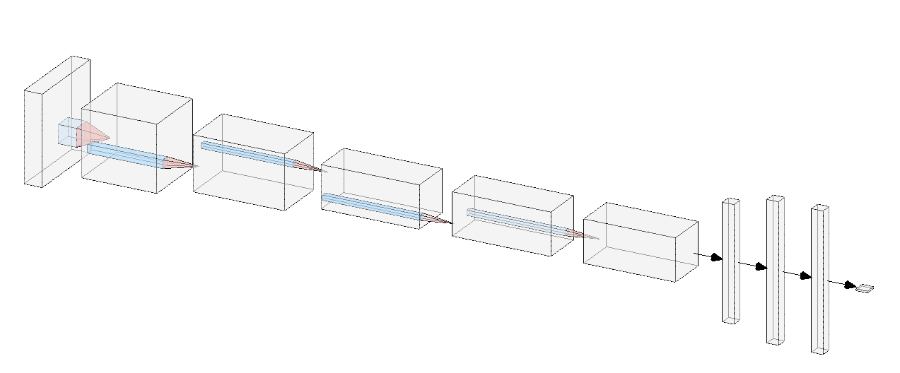
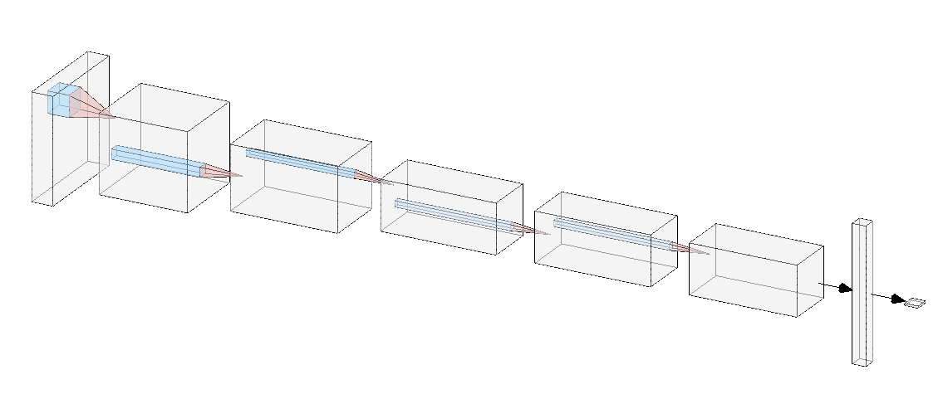
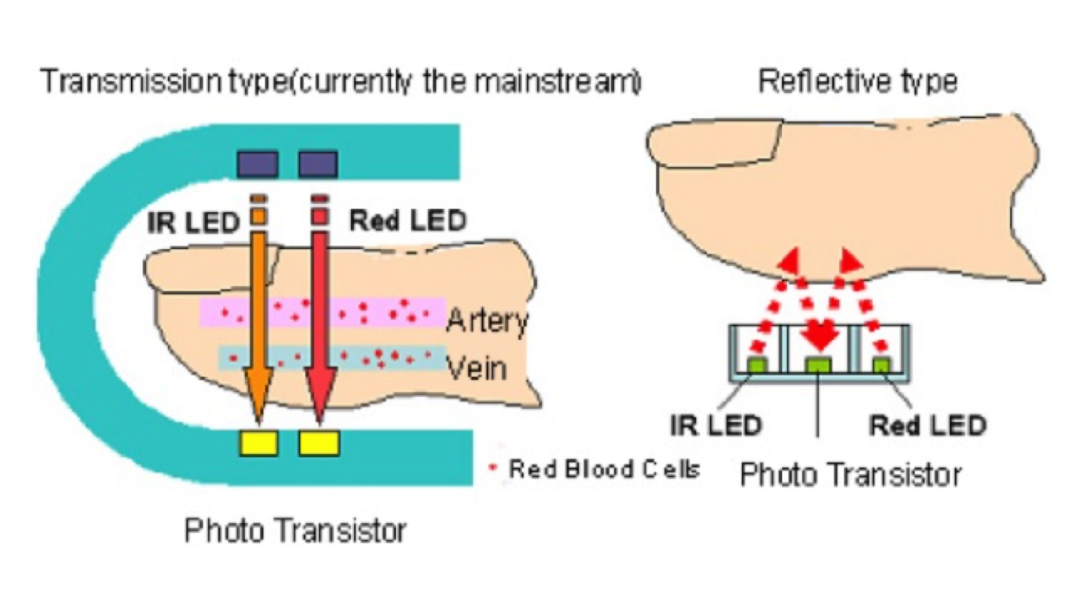
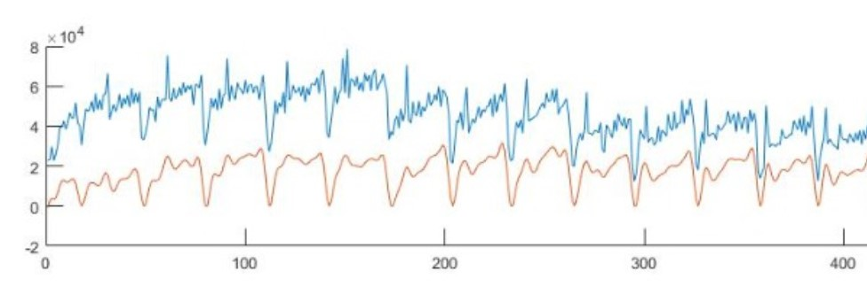



Signal and Image Processing Lab
Blood Pressure Estimation Using a Smartphone Camera
Students: Dan Ben David & Topaz Aharon
Supervisor: Yair Moshe
Blood Pressure
PPG from Smartphone
Transfer Learning
The pressure exerted upon the walls of blood vessels
Expressed using systolic / diastolic pressure
High blood pressure – “the silent killer”
Low blood pressure has also its negative effects
Continuous monitoring of blood pressure is important in many medical conditions
Mimic an oximeter using the camera and the flash light of the smartphone
MIMIC-II is a database with physiologic signals from tens of thousands of Intensive Care Unit (ICU) patients
For over 1500 patients, the database contains PPG signals with corresponding BP values
MIMIC-II
Smartphone
Goal
Extract relevant frequencies from the acquired video
Find threshold value for the red channel
Remove noisy frames
Create a PPG signal
Frequency[Hz]
Frequency[Hz]
Estimate blood pressure using a smartphone camera
Time[Sec]
Time[Sec]
Challenges
Previous project created a BP estimation network using MIMIC-II
Inspired by AlexNet architecture
We used transfer learning on this network to train the model on our dataset
Very noisy signals
Lack of tagged data
Should meet measurement accuracy standards
conv layers
fully-connected layers
PPG Signal
For every frame: 𝑅[𝑖]
If: (0.25𝑁_𝑖<𝑅[𝑖]<𝑁_𝑖 ) 𝑃𝑃𝐺[𝑖] = (𝑀𝑎𝑥 ⁡(𝑅)−𝑅[𝑖]) / (𝑀𝑎𝑥(𝑅)−𝑀𝑖𝑛(𝑅) )
Else remove frame
Remove baseline
Obtained by illuminating the skin and measuring absorption
Oximeter – infrared light and red light, transmission
Due to our small dataset, we also tried to perform transfer learning with only one fully-connected layer
$$\frac{N}{m^{2}}$$
Baseline
Raw
conv layers
fully-connected layer
Pulse
60% training 20% validation, 20% test
frames
Smartphone – white light, reflective
Data Collection
Results
Parallel sampling using a blood pressure monitor and a smartphone camera
Each sample is approximately 40sec
15 different people, 200 samples in total
Accuracy was measured as a success if the loss between the prediction and the true BP was less then 5 mmHg
Comparison to naive algorithm (average BP as an estimator)
We have achieved better results than the naive way
To meet medical standards, we should obtain
Accuracy over 95%
Loss < 5 mmHg
We believe that acquiring a larger labeled database from smartphones will significantly improve results
System Scheme
Preprocessing
Offline
Transfer learning
accuracy: 45.0
loss: 9.66
Naive
accuracy: 0.0
loss: 18.84
PPG with
BP label
Preprocessing
Training
Model
Convert video to PPG
Upsample from 30Hz to 125Hz
Cut middle 30 sec
Smartphone PPG with BP label
Transfer Learning
Refined Model
Online
Pulse [$\frac{N}{m^{2}}$]
Video from smartphone
Video to PPG
PPG signal
Preprocessing
Blood Pressure Estimation
Time[Sec]
$$[Sec]$$
Transform to a spectrogram
Systolic/Diastolic values
Frequency[Hz]
Time[Sec]

